Slide 1





RFID
Home
Discussion
Conclusion
Contact
RFID Security
RFID Security and the Risk of Cloning
Prepared by:
Mamouni Khouloud

Slide 2
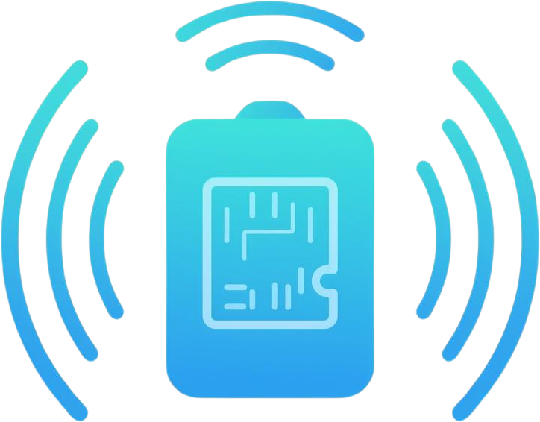
RFID
Home
Discussion
Conclusion
Contact
Introduction to RFID
RFID (Radio Frequency Identification) is a wireless technology that uses radio waves to identify objects without physical contact. It works by sending data between a tag and a reader, which makes identification fast and easy. RFID is used in many areas such as access cards, public transport, payment systems, and product tracking.

Slide 3
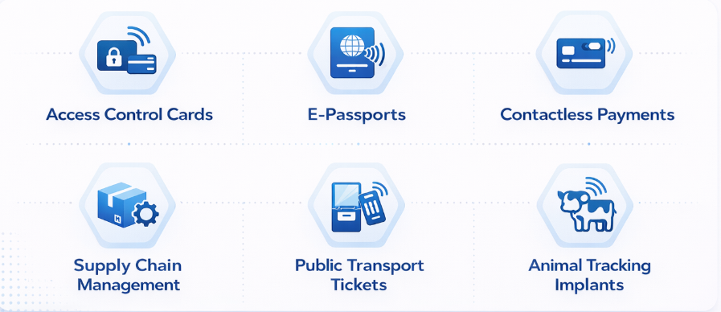
RFID
Home
Discussion
Conclusion
Contact
Common Application of RFID

Slide 4
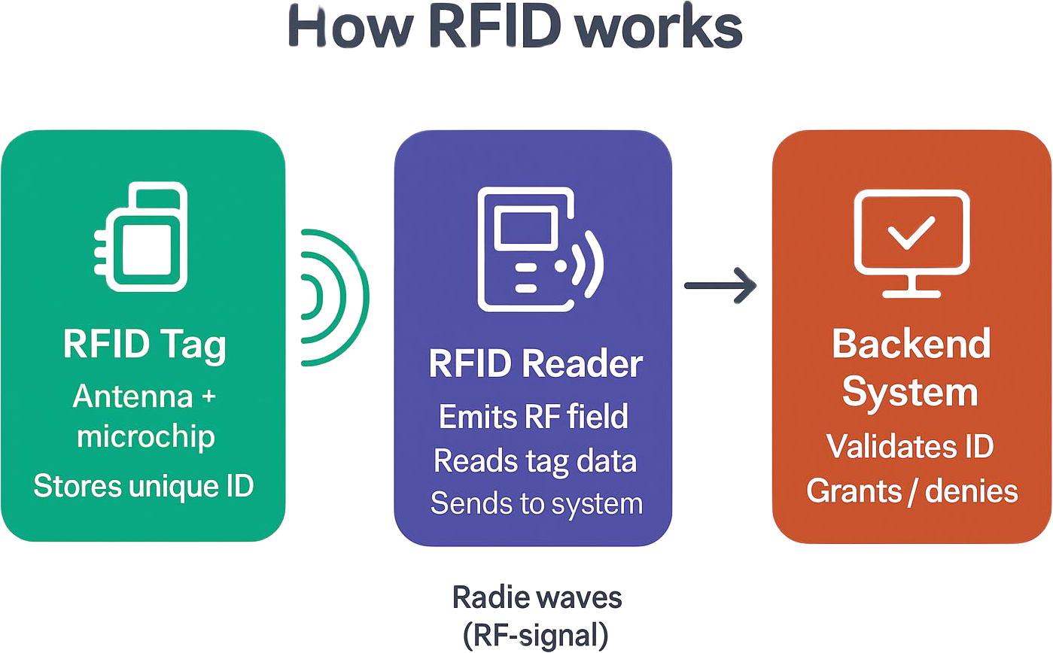
RFID
Home
Discussion
Conclusion
Contact
How RFID works ?

Slide 5
RFID
Home
Discussion
Conclusion
Contact
The Step Cycle
1
3
5
Field Generation
Command TX
Decode & Foraward
Reader detects fluctuations
Extracts UID → sends to backend
Reader broadcasts carrier wave
13.56 MHz (HF) or 125 kHz (LF)
Reader modulates wave
Sends SELECT command (ISO 144a43)
2
4
Power Harvesting
Load Modulation
Tag antenna absorbs RF energy
Powers chip — no battery needed
Tag switches resistive load
Encodes bits via field fluctuations

Slide 6

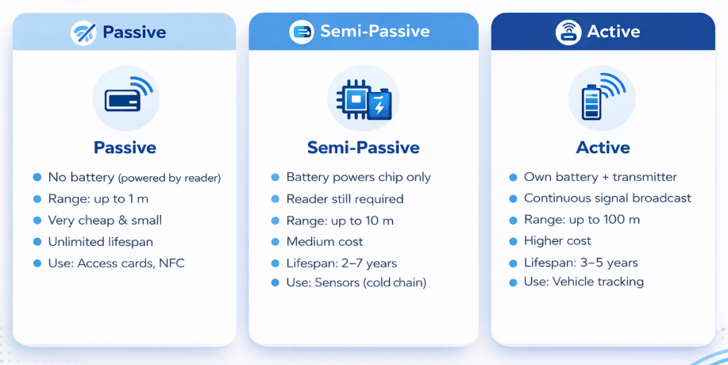
RFID Security
Home
Discussion
Conclusion
Contact
Types of RFID Tags

Slide 7
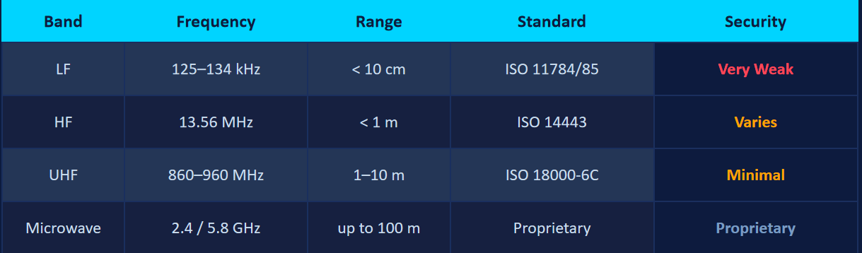
RFID
Home
Discussion
Conclusion
Contact
RFID Frequency Bands

Slide 8

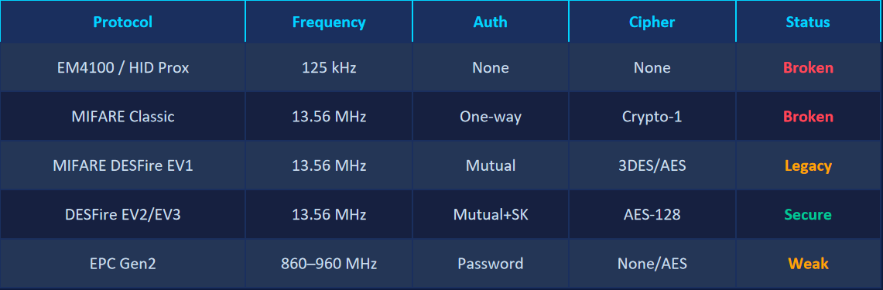
RFID Security
Home
Discussion
Conclusion
Contact
Protocols & Cryptographic Algorithms

Slide 9

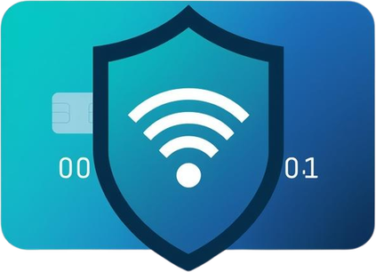

Home
Discussion
Conclusion
Contact
RFID Security
Security Challenges
No reader authentication
    The card does not verify the reader soany device even a malicious one can read it.
No user awareness
    Users cannot see or feel what is happening, since communication occurs silently in their pocket.
Wireless attacks
    Attacks can happen remotely without physical contact and without the user noticing.
Old systems still used
    Many old and insecure cards are still in use because replacing them is expensive and difficult.

Slide 10


Home
Discussion
Conclusion
Contact
RFID Security
Common Attack
Eavesdropping
The attacker secretly listens to the communication between the card and the reader using a hidden antenna.
Replay Attack
The attacker records a valid signal and reuses it later to gain access.
Relay Attack
The attacker uses two devices to extend the signal between the card and the reader over a long distance.
Key Recovery
The attacker breaks weak encryption to find the secret key in a short time.
DoS / Jamming
The attacker blocks communication by sending noise, so the system stops working.
Cloning
The attacker copies all the card data to another card, creating an exact duplicate.

Slide 11
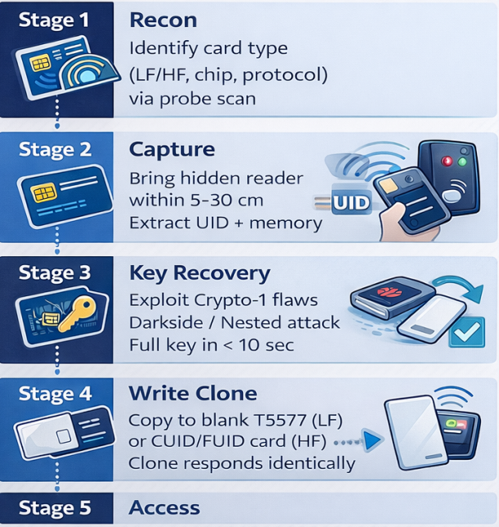
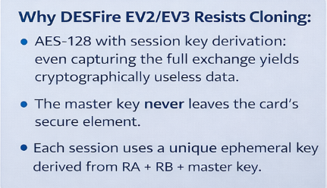
Home
Discussion
Conclusion
Contact
RFID Security
Cloning Attack

Slide 12
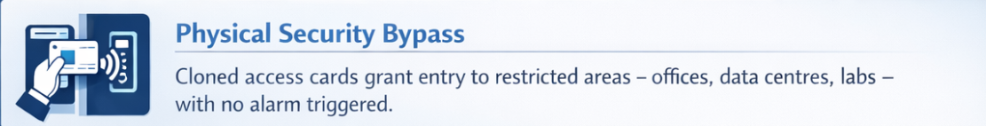



Home
Discussion
Conclusion
Contact
RFID Security
Risks of RFID Cloning

Slide 13
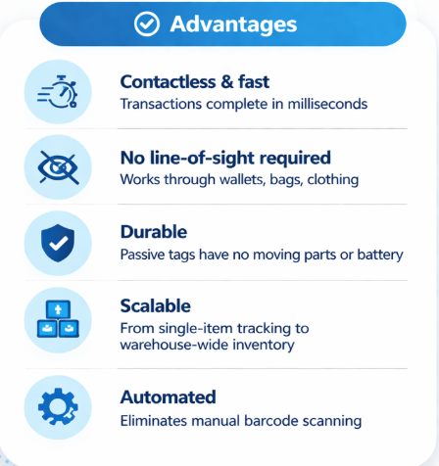
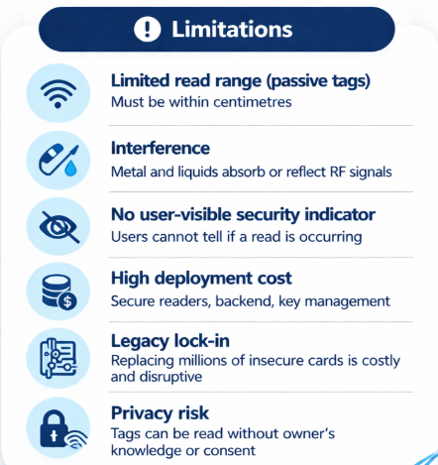
RFID
Home
Discussion
Conclusion
Contact
Advantages & Limitations

Slide 14
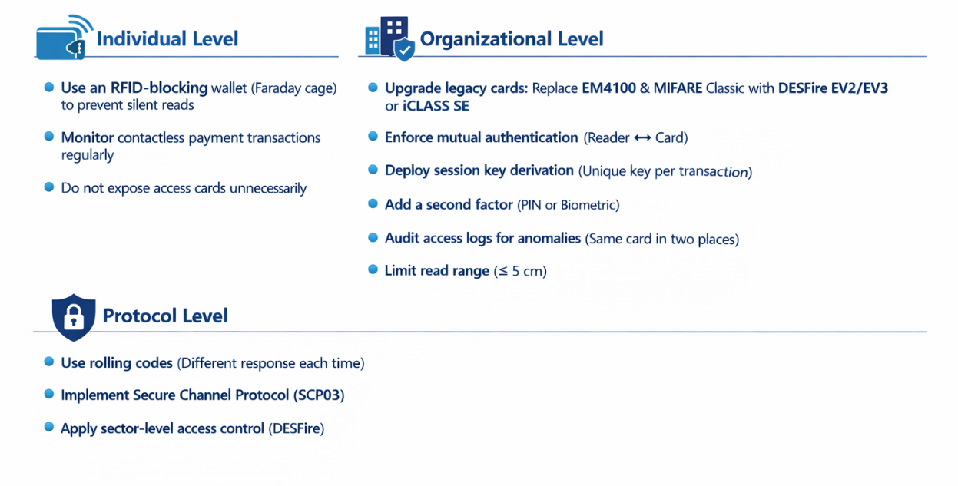
RFID
Home
Discussion
Conclusion
Contact
How to Protect Yourself

Slide 15

RFID
Home
Discussion
Conclusion
Contact
Conclusion
RFID is widely used in many areas, but its security depends on the system used. Old cards are not secure and can be easily cloned, while modern encrypted systems are safer. Strong security requires multiple layers like updated hardware, monitoring, and user awareness.

Slide 16
RFID
Home
Discussion
Conclusion
Contact
References
  Nohl, K., Evans, D., Starbug & Plötz, H. (2008). Reverse-Engineering a Cryptographic RFID Tag. USENIX Security Symposium
  Garcia, F. et al. (2008). Dismantling MIFARE Classic. ESORICS
  ISO/IEC 14443 — Identification cards: Contactless integrated circuit cards — Proximity cards
  ISO/IEC 15693 — Vicinity cards
  NXP Semiconductors — MIFARE DESFire EV3 Product Brief (2020)
  Juels, A. (2006). RFID Security and Privacy: A Research Survey. IEEE Journal on Selected Areas in Communications
  Hancke, G. (2005). A Practical Relay Attack on ISO 14443 Proximity Cards

Slide 17

RFID
Home
Discussion
Conclusion
Contact
Thank You
Do you have any questions?
kholoud09726@gmail.com

